Slide 1
Exams will be
returned in class
Thursday

Slide 2
Tips
Come to office hours
Ask questions in class or on chat room
Do HW, try unassigned homework problems in text or on WileyPlus
Read other textbooks, web sites
Time management: maximize points
Units are important
Focus on the subject matter, not the exams
Final Exam is 35%, Thursday May 17th, 1-3 PM

Slide 3
Chapter 16: Composite Materials
ISSUES TO ADDRESS...
• What are the classes and types of composites?
• Why are composites used instead of just metals,
ceramics, or polymers?
• How do we estimate composite stiffness & strength?
• What are some typical processes and applications?

Slide 4
Composites
Combine different materials with the objective of getting a more desirable combination of properties
Ex: get flexibility & light weight of a polymer plus the strength of a ceramic
Principle of combined action
Mixture gives “averaged” properties
Steels, other alloys are really “composites”, but term is usually used to describe materials where the separate components are mixed together later
Notes:
Don’t always get what you want
Ex: combine ferret (pet) + mink (fur)
Desire a mink with good disposition but got a nasty ferret

Slide 5
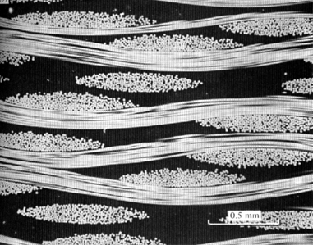
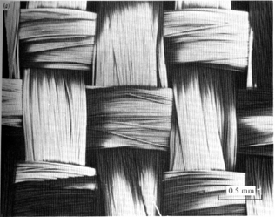
Terminology/Classification
• Composites:
-- Multiphase material w/significant
proportions of each phase.
woven
fibers
• Matrix:
-- The continuous phase
-- Purpose is to:
- transfer stress to other phases
- protect phases from environment
-- Classification: MMC, CMC, PMC
0.5
mm
cross
section
view
metal
ceramic
polymer
• Dispersed phase:
-- Purpose: enhance matrix properties.
MMC: increase σy, TS, creep resist.
CMC: increase Kc
PMC: increase E, σy, TS, creep resist.
-- Classification: Particle, fiber, structural
0.5
mm

Slide 6
Composite Survey

Slide 7
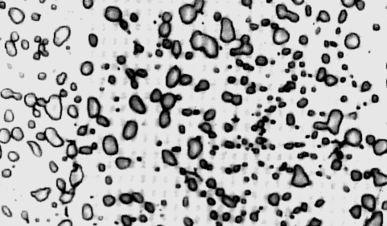
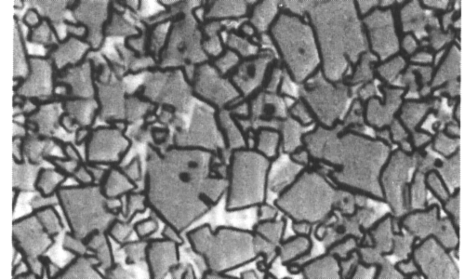
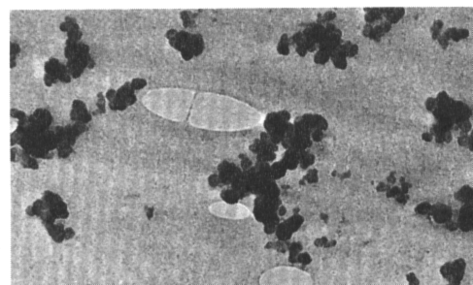
Composite Survey: Particle-I
Particle-reinforced
Fiber-reinforced
Structural
• Examples:
- Spheroidite
matrix:
particles:
steel
ferrite (α)
cementite
(ductile)
(
Fe
3
C
)
(brittle)
60 μm
- WC/Co
matrix:
particles:
cemented
cobalt
WC
carbide
(ductile)
(brittle,
V
m
:
hard)
10-15 vol%
600 μm
- Automobile
matrix:
particles:
tires
rubber
C
(compliant)
(stiffer)
0.75 μm

Slide 8
Composite Survey: Particle-II
Particle-reinforced
Fiber-reinforced
Structural
Concrete – gravel + sand + cement
- Why sand and gravel? Sand packs into gravel voids
Reinforced concrete - Reinforce with steel rerod or remesh
- increases strength - even if cement matrix is cracked
Prestressed concrete - remesh under tension during setting of concrete. Tension release puts concrete under compressive force
- Concrete much stronger under compression.
- Applied tension must exceed compressive force
Post tensioning – tighten nuts to put under tension
threaded
rod
nut

Slide 9
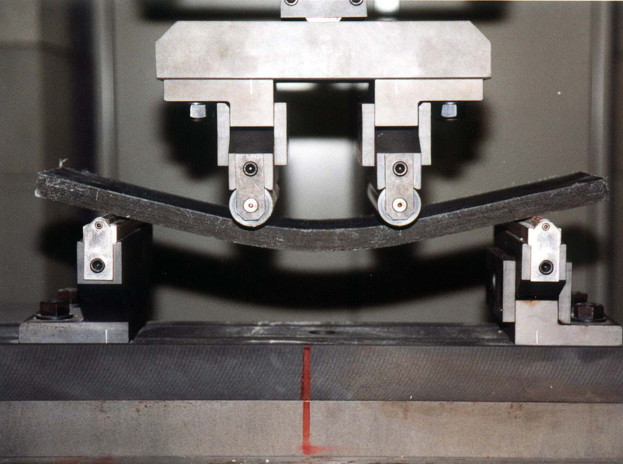
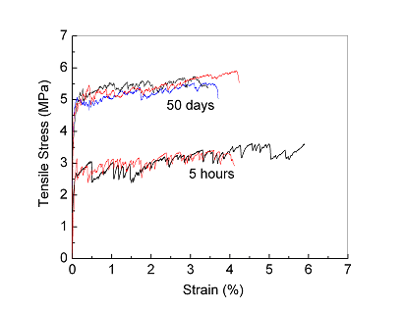
Victor Li: PVA-cement composites
Tough, rapid setting
cement-based materials
by incorporating polymer
fibers into mixture

Slide 10
Composite Survey: Particle-III
Particle-reinforced
Fiber-reinforced
Structural
• Elastic modulus, Ec, of composites:
-- two approaches.
upper
limit:
“rule of mixtures”
E
c
=
V
m
E
m
+
V
p
E
p
E(GPa)
Data:
350
lower limit:
Cu matrix
30
0
V
w/tungsten
250
1
=
V
m
+
p
particles
20
0
E
c
E
m
E
p
150
0
20
4
0
6
0
8
0
10
0
vol% tungsten
(Cu)
(
W)
• Application to other properties:
-- Electrical conductivity, σe: Replace E in equations with σe.
-- Thermal conductivity, k: Replace E in equations with k.

Slide 11
Composite Survey: Fiber-I
Particle-reinforced
Fiber-reinforced
Structural
Fibers very strong
Provide significant strength improvement to material
Ex: fiber-glass
Continuous glass filaments in a polymer matrix
Strength due to fibers
Polymer holds them in place
Polyesters, polyimides, epoxies

Slide 12
Composite Survey: Fiber-II
Particle-reinforced
Fiber-reinforced
Structural
Fiber Materials
Whiskers - Thin single crystals - large length to diameter ratio
graphite, SiN, SiC
high crystal perfection – extremely strong, strongest known
very expensive
Fibers
polycrystalline or amorphous
generally polymers or ceramics
Ex: Al₂O₃ , Aramid, E-glass, Boron, UHMWPE, carbon
Wires
Metal – Steel, Mo, W

Slide 13
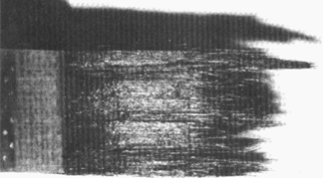
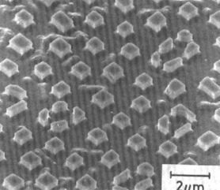
Composite Survey: Fiber-III
Particle-reinforced
Fiber-reinforced
Structural
• Aligned Continuous fibers
• Examples:
-- Metal: γ'(Ni3Al)-α(Mo)
by eutectic solidification.
-- Ceramic: Glass w/SiC fibers
formed by glass slurry
Eglass = 76 GPa; ESiC = 400 GPa.
matrix:
α
(Mo) (ductile)
(a)
fracture
surface
2 μm
fibers:
γ
’ (Ni₃Al) (brittle)
(b)

Slide 14
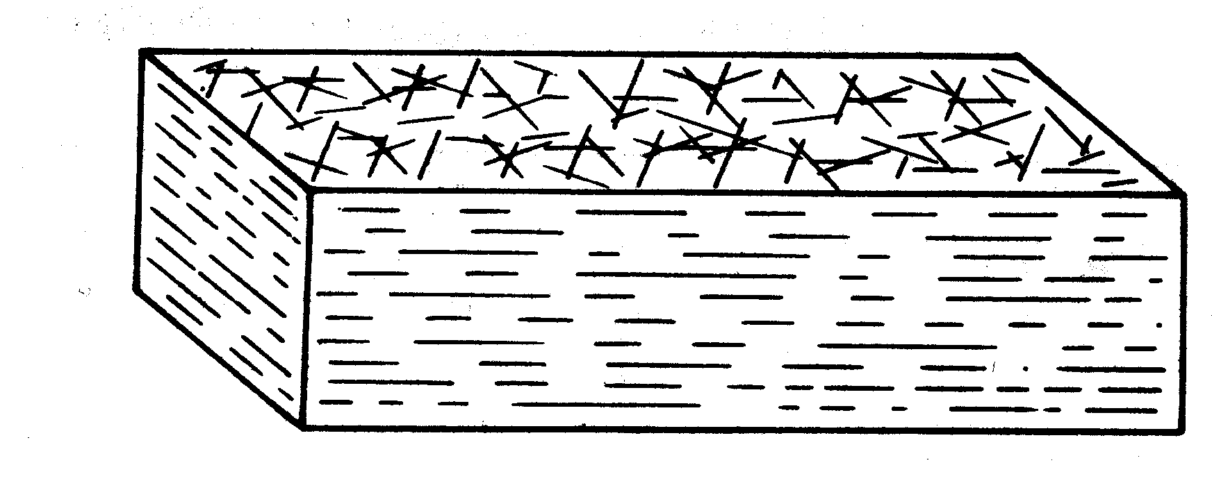
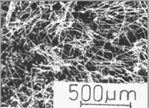
Composite Survey: Fiber-IV
Particle-reinforced
Fiber-reinforced
Structural
• Discontinuous, random 2D fibers
• Example: Carbon-Carbon
-- process: fiber/pitch, then
burn out at up to 2500ºC.
-- uses: disk brakes, gas
turbine exhaust flaps, nose
cones.
C fibers:
very stiff
very
strong
(b)
C matrix:
less stiff
view onto plane
less strong
• Other variations:
-- Discontinuous, random 3D
glass in nylon or PP
-- Discontinuous, 1D
fibers lie
(a)
in plane

Slide 15
Composite Survey: Fiber-V
Particle-reinforced
Fiber-reinforced
Structural
• Critical fiber length for effective stiffening & strengthening:
fiber strength in tension
fiber diameter
shear strength of
fiber-matrix interface
• “Continuous” fibers when l > 15 l_{c}
Typical L/D: 20-150
• Why? Longer fibers carry stress more efficiently
Shorter, thicker fiber:
Longer, thinner fiber:
σ
(x)
σ
(x)
Poorer fiber efficiency
Better fiber efficiency

Slide 16
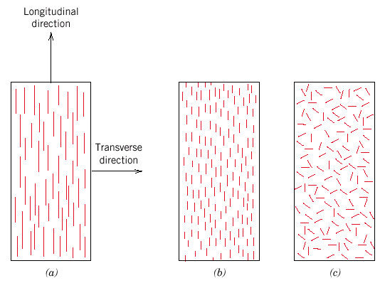
Fiber Alignment
aligned
continuous
aligned random
discontinuous

Slide 17
Composite Strength: Longitudinal Loading
Continuous fibers - Estimate fiber-reinforced composite strength for long continuous fibers in a matrix
Longitudinal deformation
σ_{c} = σ_{m}V_{m} + σ_{f}V_{f} but ε_{c} = ε_{m} = ε_{f}
volume fraction isostrain
E_{ce} = E_{m} V_{m} + E_{f}V_{f} longitudinal (extensional)
modulus
f = fiber
m = matrix

Slide 18
Composite Strength: Transverse Loading
In transverse loading the fibers carry less of the load - isostress
σ_{c} = σ_{m} = σ_{f} = σ ε_{c}= ε_{m}V_{m} + ε_{f}V_{f}
∴
transverse modulus

Slide 19
Composite Strength
Particle-reinforced
Fiber-reinforced
Structural
• Estimate of Ec for discontinuous fibers:
-- valid when
-- Elastic modulus in fiber direction:
E_{c} = E_{m}V_{m} + KE_{f}V_{f}
efficiency factor:
-- aligned 1D: K = 1 (aligned )
-- aligned 1D: K = 0 (aligned )
-- random 2D: K = 3/8 (2D isotropy)
-- random 3D: K = 1/5 (3D isotropy)

Slide 20
Composites Processing: Lay-Up
Lay fabric of reinforcement in layers
Pour in reinforcement over fibers in a container (open molding)
Contain object in a bag or two-sided mold, apply curing with temperature or crosslinking radiation (closed molding)
electrons, light, X-rays

Slide 21
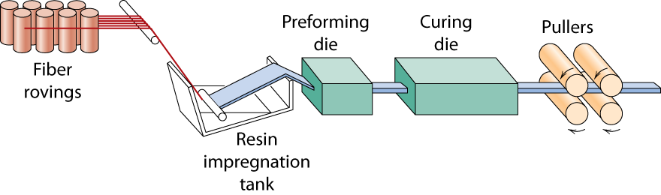
Composite Production Methods-I
Pultrusion
Continuous fibers pulled through resin tank, then preforming die & oven to cure

Slide 22
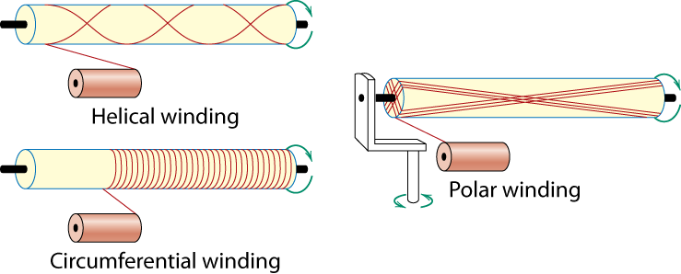
Composite Production Methods-II
Filament Winding
Ex: pressure tanks
Continuous filaments wound onto mandrel

Slide 23
Resin Transfer Molding: RTM
1: Cope 2: Drag 3: Clamp 4: Mixing chamber 5: Fiber preform
6: Heated mold 7: Resin 8: Curative
Can be done with Vacuum Assist: VARTM

Slide 24
Common Defects in RTM

Slide 25
Reinforced Reaction Injection Molding (RRIM)
Matrix: polyurethanes, polyureas (no reaction byproducts)
Reinforcement: glass fibers, mica, calcium carbonate
Products: bumpers, spoilers, fenders
Lower pressures (small molecules flow easier), but more expensive materials, somewhat slower than injection molding of polymer melts

Slide 26
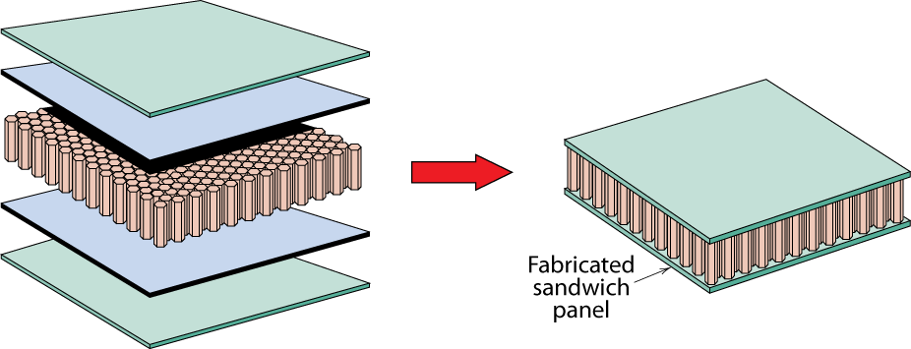
Composite Survey: Structural
Particle-reinforced
Fiber-reinforced
Structural
• Stacked and bonded fiber-reinforced sheets
-- stacking sequence: e.g., 0º/90º
-- benefit: balanced, in-plane stiffness
• Sandwich panels
-- low density, honeycomb core
-- benefit: small weight, large bending stiffness
face sheet
adhesive layer
honeycomb

Slide 27
Composite Benefits
• CMCs: Increased toughness
• PMCs: Increased E/ρ
Force
3
ceramics
particle-reinf
10
E(GPa)
PMCs
10
2
10
metal/
fiber-reinf
1
metal alloys
un-reinf
.1
polymers
.01
Bend displacement
.1
.3
1
3
10
30
10
-4
Density, ρ [mg/m³]
ε
(s⁻¹)
6061 Al
ss
• MMCs:
Increased
creep
resistance
10
-6
10
-8
6061 Al
w/SiC
whiskers
σ
(MPa)
10
-10
20
30
50
100
200

Slide 28
Material property- charts: Modulus - Density
E/ρ (1)
1000
Ceramics
100
E/ρ (2)
Composites
10
Woods
Young’s modulus E, (GPa)
Metals
1
Foams
Polymers
0.1
Elastomers
0.01
0.1
1
10
100
Density (Mg/m³)
Unit 1, Frame 1.16

Slide 29
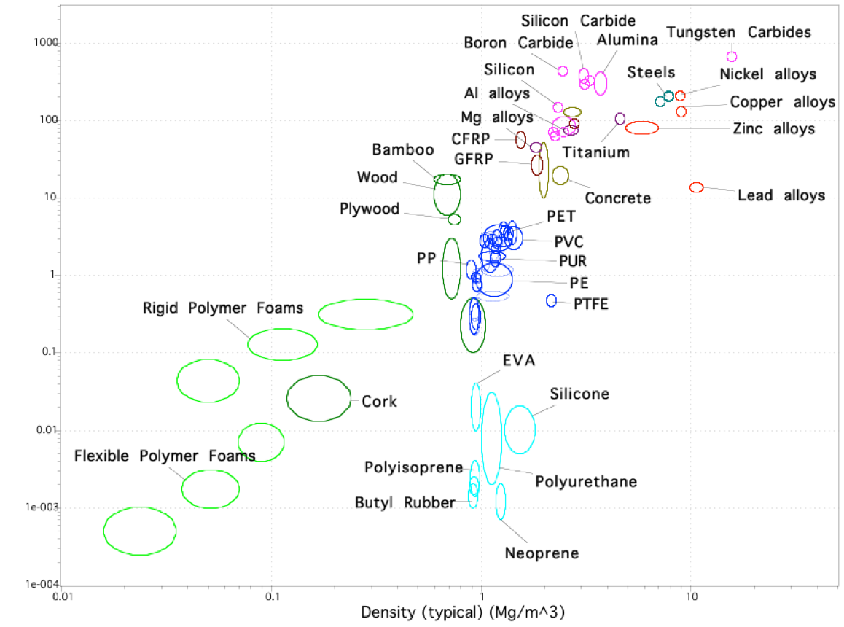
Specfic Materials
Modulus - Density
Young’s modulus (GPa)
Density (Mg/m³)
Unit 1, Frame 1.18

Slide 30
Specfic Materials
Modulus - Density
Young’s modulus (GPa)
Density (Mg/m³)
Unit 1, Frame 1.18

Slide 31
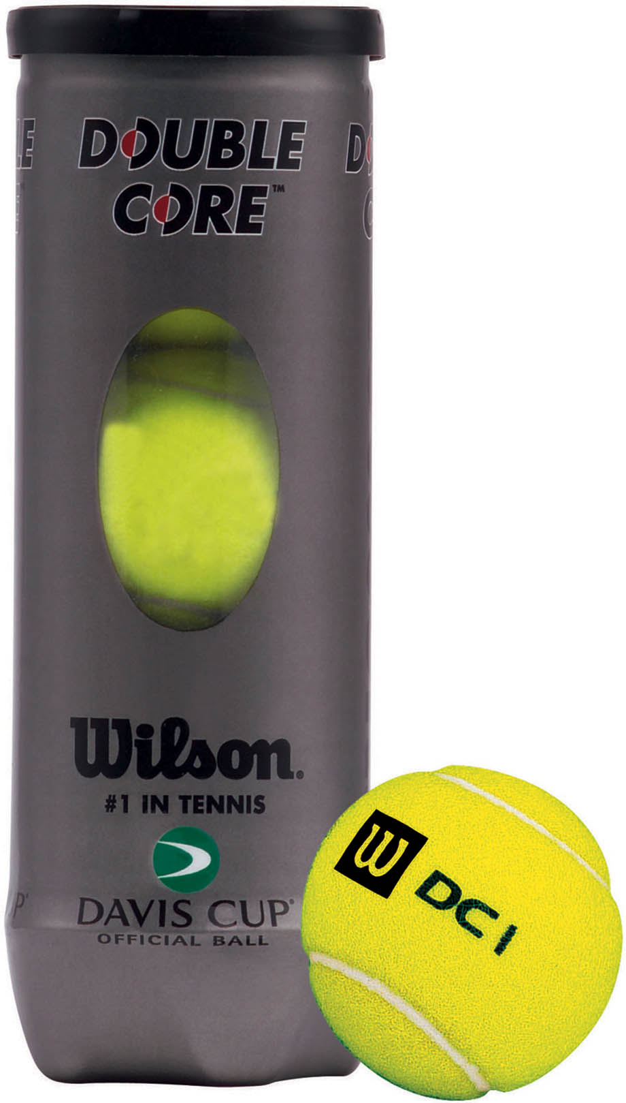
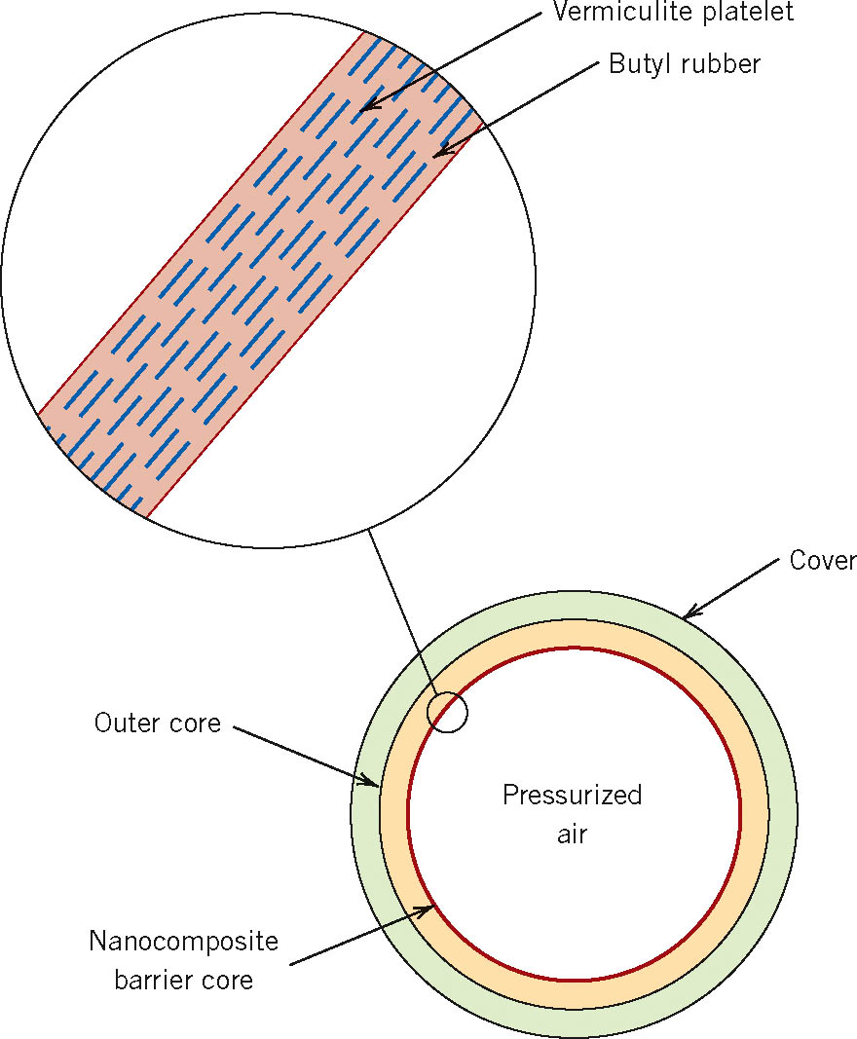
Nanocomposites

Slide 32
Composites at UD
Interdisciplinary Center for Composite Materials (CCM)
Students get degrees from partnering departments: MEEG, MSEG, CIEG, ChEG, BMEG, ELEG
Current director: Jack Gillespie
MSEG, CIEG, MEEG
ccm.udel.edu

Slide 33
CCM Research Areas
Materials and Synthesis
Mechanics and Design
Multifunctional Materials
Performance
Processing Science
Sensing and Control
Product Development
Engineering Services

Slide 34
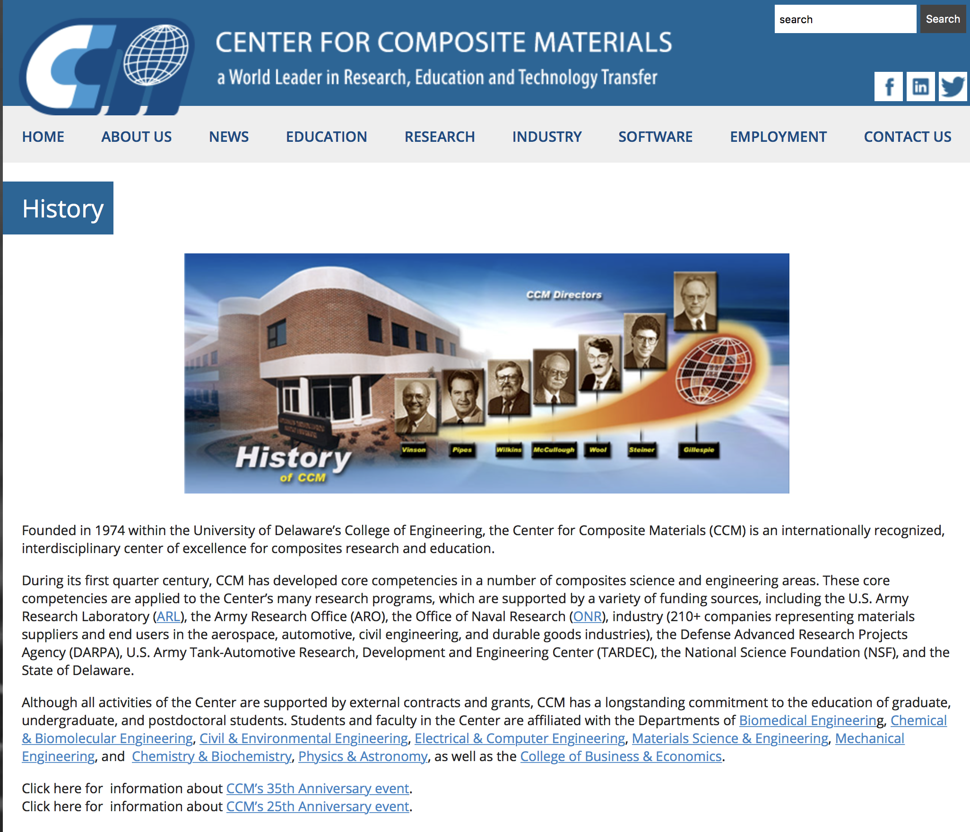

Slide 35
LaShanda Korley: CWRU -> UD
Bio-inspired Materials and Systems
1) Silk-inspired Nanocomposites
2) Spider / Caddisfly Silk Mimics
3) Sea Cucumber, Squid Beak, and Pine Cone Inspired Adaptive Composites
4) Dynamic and Functional Fibers Inspired by the Extracellular Matrix
5) Soft Robotics Inspired by Worm Locomotion

Slide 36


Slide 37
Summary
• Composites are classified according to:
-- the matrix material (CMC, MMC, PMC)
-- the reinforcement geometry (particles, fibers, layers).
• Composites enhance matrix properties:
-- MMC: enhance σy, TS, creep performance
-- CMC: enhance Kc
-- PMC: enhance E, σy, TS, creep performance
• Particulate-reinforced:
-- Elastic modulus can be estimated
-- Properties are isotropic
• Fiber-reinforced:
-- Elastic modulus and TS can be estimated along fiber dir.
-- Properties can be isotropic or anisotropic.
• Structural:
-- Based on build-up of sandwiches in layered form

